Slide 1
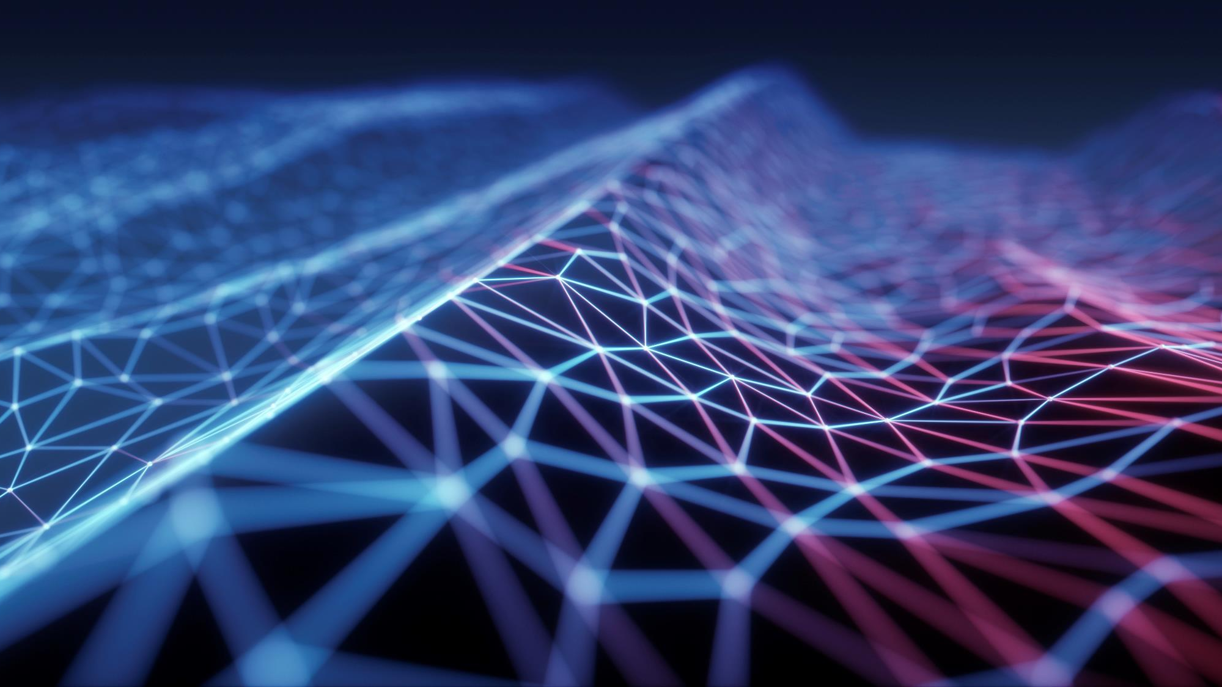

TOCSIN 1.O
( sYSTEM UTILITY SOFTWARE)

Slide 2
Inspiration:
During the Drowsiness ,user of the computer may not shut down the system. It causes battery drainage and reduce the performance of system in long run. Automatic sleep mode is not possible during the processing of multimedia files in personal computer. To overcome this problem, we create the Tocsin.

Slide 3
Problem description:
During the time of media file processing (Streaming video on-line / off-line ) the user may fall asleep, But the processing of media file still continue.If the media file run more then 2 hours continuously it causes heavy battery consumption.

Slide 4
Solution:​
Tocsin is upgraded version of drowsiness detection model .This helps the user to find the Last active session in a multimedia file and improve the system performance by reducing battery consumption.

Slide 5
Working progress:
1.user need to activate the tocsin before going to streaming media files
2.If user get drowsiness or not watching the screen, Tocsin gives alarm in interval basis .(for example it will give alarm if user not focus on the system screen more then 3 Min.)
3.This loop going to one more time.if user eye not detected, it will take screen shot of the current screen in user specific folder.and shut-down the system.

Slide 6
4.Advantage: -
1.Increase the system performance in long run
2.Help the user to find last activate section in multimedia file by storing the screen shot of multimedia file.
3.user friendly application interface which provide the easy customization to user.

Slide 7
5.Future Scope: -
1.Tocsin 1.o is window based standalone application.in future model(Tocsin 2.o) will come up with support of Android application.
6.Limitations: -
Tocsin only work in day time. During the night time, Tocsin may fail because of low light mode.it can overcome by night vision camera.

Slide 8

Technical Requirements
Hardware:
Laptop with web camera and System
specification: At least 4Gb ram,500 GB Hard disk space.
Software:
Programming language: Python
Library used: Open-Cv, dlib library
User interface: Tkinter

Slide 9
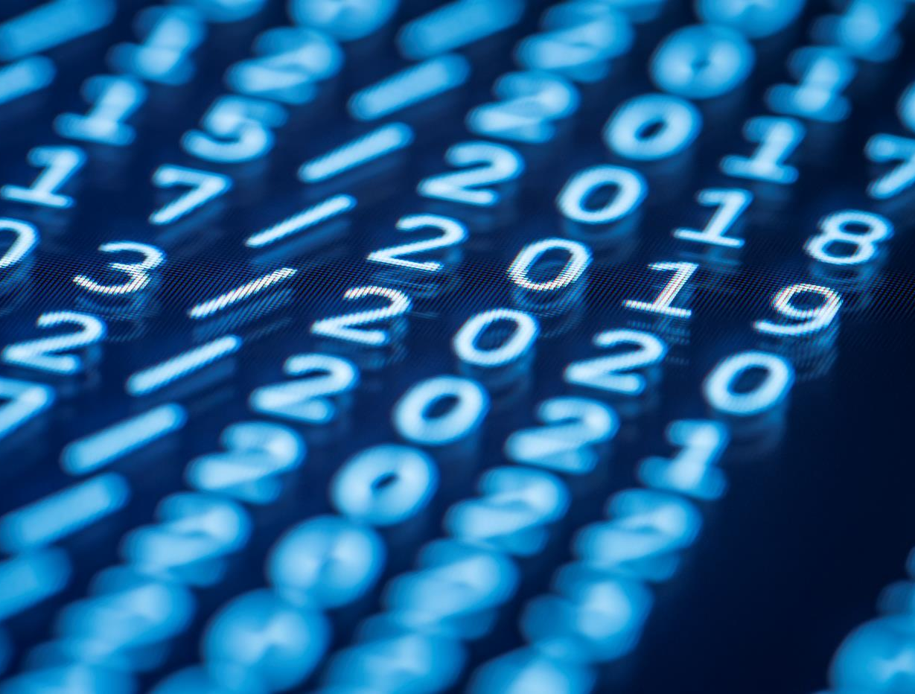

Thank You

